Slide 1

WhereSIOUS - San Diego
Where Should I Open Up Shop?
Jeffrey Silverman

Slide 2
WhereSIOUS - San Diego
Where Should I Open Up Shop?
Jeffrey Silverman
Should my new restaurant go here?
Is this a good place for my next car dealership?
Notes:
The City of San Diego wants to use DATA to improve things.
Specifically, using information about different parts of SD and how well businesses have done there in the past, I can predict the place where businesses will be most successful.

Slide 3
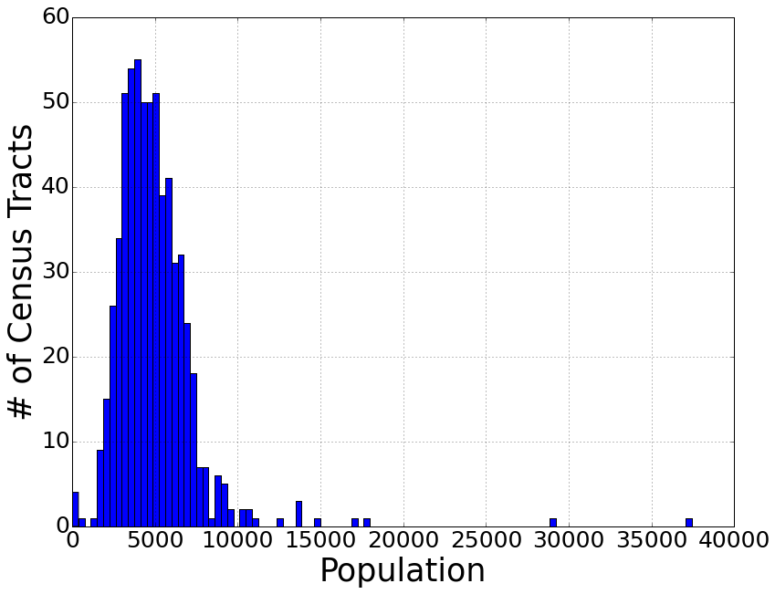
Census Tracts
average population
per census tract ≈ 4930
Notes:
Census tracts are subdivisions used by the US Census.
There are supposed to be about 5000 people in each census tract, which seems to be true for the city of SD.
Of course this means that there’s a wide range in the physical sizes of different census tracts with very sparsely populated tracts being physically much larger.
This is the resolution of my model, in other words, I predict how successful a business will be in a given census tract.

Slide 4
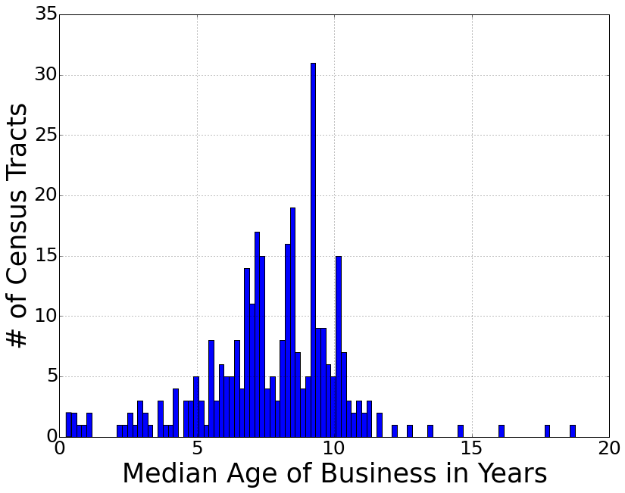
Longevity == Business Success
typical business age ≈ 8 years
56,710 businesses in 314 census tracts
Notes:
After discussions with SD officials, including people in the Data Office and the Business Development Office, we decided, given the dataset, that a good measure of a business’ success is how long it’s been around.
So I took the list of all current businesses in SD and calculated the median age of all businesses in each census tract.

Slide 5

Longevity → “WhereSIOUS Score”
average WhereSIOUS score ≈ 41
Notes:
To avoid overinterpreting my results as a direct estimate of business lifetime, I scaled the ages of the businesses to numbers between 1 and 100 that I call the WhereSIOUS score.
So my model predicts the WhereSIOUS score for a given census tract and that number gives a sense of how successful a business will be in that tract where larger numbers correspond to a more successful business.

Slide 6



From Data to WhereSIOUS Score
population, housing, income, & employment data, census tracts
describe each census tract & their businesses
SD business age & location, type of business

Slide 7
From Data to WhereSIOUS Score
linear regression with input data & calculated WhereSIOUS scores
population, housing, income, & employment data, census tracts
describe each census tract & their businesses
SD business age & location, type of business

Slide 8
From Data to WhereSIOUS Score
linear regression with input data & calculated WhereSIOUS scores
population, housing, income, & employment data, census tracts
predict WhereSIOUS score for each census tract
describe each census tract & their businesses
SD business age & location, type of business

Slide 9
From Data to WhereSIOUS Score
linear regression with input data & calculated WhereSIOUS scores
population, housing, income, & employment data, census tracts
predict WhereSIOUS score for each census tract
describe each census tract & their businesses
SD business age & location, type of business
output WhereSIOUS score for a given census tract

Slide 10
From Data to WhereSIOUS Score
linear regression with input data & calculated WhereSIOUS scores
population, housing, income, & employment data, census tracts
predict WhereSIOUS score for each census tract
user enters an address (& optional business type)
describe each census tract & their businesses
convert
address to
census tract
SD business age & location, type of business
output WhereSIOUS score for a given census tract

Slide 11
From Data to WhereSIOUS Score
linear regression with input data & calculated WhereSIOUS scores
population, housing, income, & employment data, census tracts
predict WhereSIOUS score for each census tract
user enters an address (& optional business type)
describe each census tract & their businesses
convert
address to
census tract
SD business age & location, type of business
output WhereSIOUS score for a given census tract
website!

Slide 12
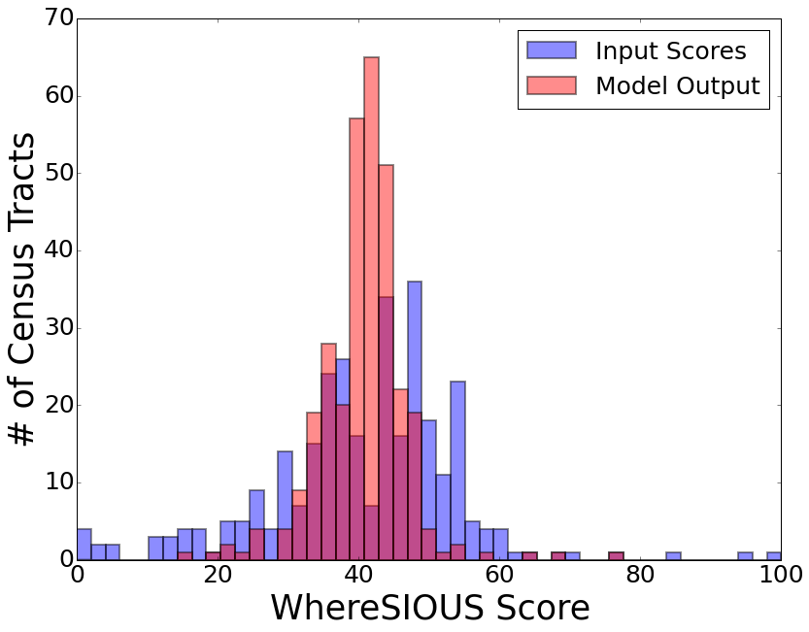
Input Scores vs. Model Output
22 input features
r² ≈ 0.21
Notes:
10x better than just using # of businesses in each census tract
2x better than using # of businesses, but cutting some of the most extreme outliers
My resulting range of Scores is narrower than the input, which is good since the really high and really low scoring tracts all have very few businesses in them (i.e., small number stats) so they aren’t very trustworthy for the model.

Slide 13





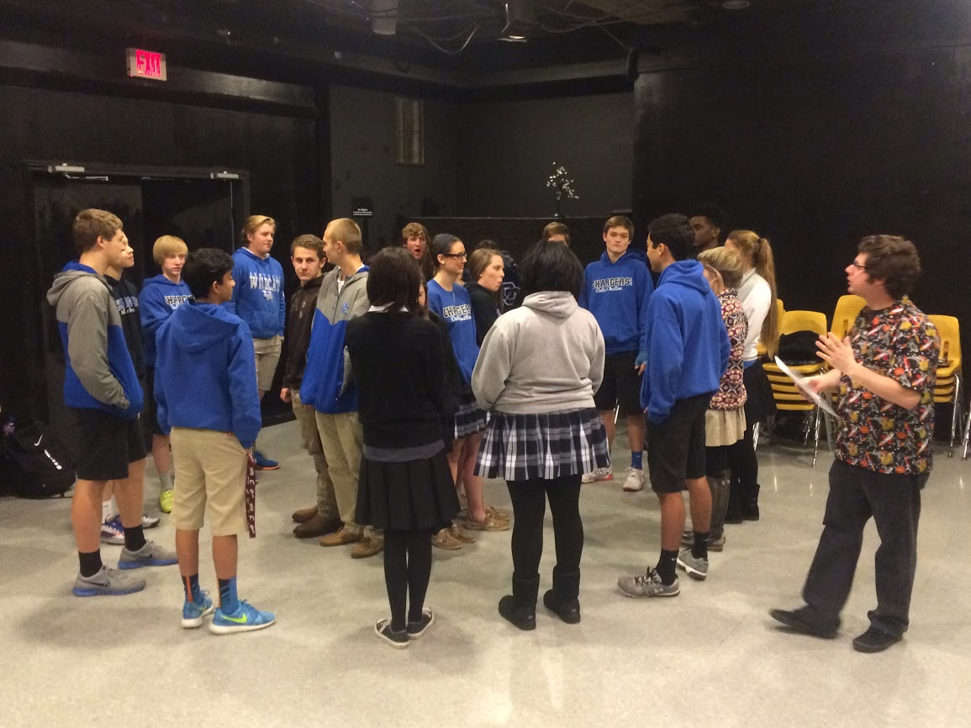
Jeffrey Silverman

